Slide 1
Popularity of Rap Music
Ishan Koroth
Link to an Rpubs version of the Markdown: https://rpubs.com/ik4vrb/998724

Slide 2
Background
Question: What attributes influence the popularity of a rap song?
We are asking this question because we are all music fans, though each of us likes different artists, genres, and specific songs. Often when we first hear a song, we have a reaction to whether or not we like it; however, this is more based on a general feeling. We are wondering what data science can reveal about what attributes of songs contribute to whether it is popular or not.
For this project, I will be using a Spotify playlist data set.
One of the main reasons why I chose this project is because I am interested in music (currently doing a major in music as well) and am curious about what type of music people like in general. Rap was one genre I was particularly interested in due to such a genre seeing elevation in overall popularity.

Slide 3
Methods
To answer the question of what attributes influence the popularity of a song and how this compares between genres, we will use a decision tree.
The decision tree will allow us to visually represent the importance of different quantifiable attributes of a song in predicting popularity.
Originally, we planned to create decision tree models with the target variable being track_popularity as a continuous variable from 0-100. For this we planned to use Rsquared and RMSE as our evaluation metrics. However, when training the initial models to predict this continous varaible, we found that the accuracy of the models were extremely low. No attempts at tuning the decision tree model produced a significant improvement in regard to either evaluation metric.
This led us to return to our original question and shift our approach. Instead of predicting the continous variable, we decided to split track_popularity for each genre into two buckets: high and low popularity.
The thought behind this was that the exact number for popularity was not truly what was important for an artist. Instead, what may be important is simply whether a song has high popularity in comparison to other songs in the same genre. The evaluation metric that we used for these models was Kappa because Kappa is a useful evaluation metric for multi-class models.

Slide 4
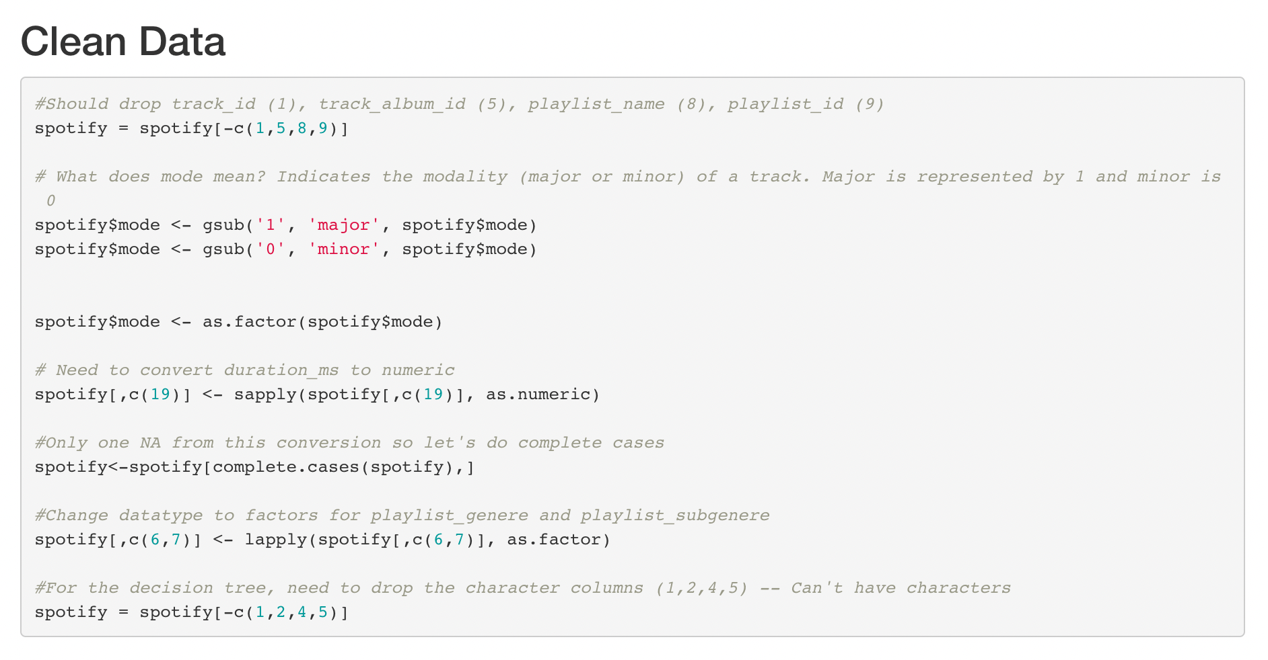

Slide 5
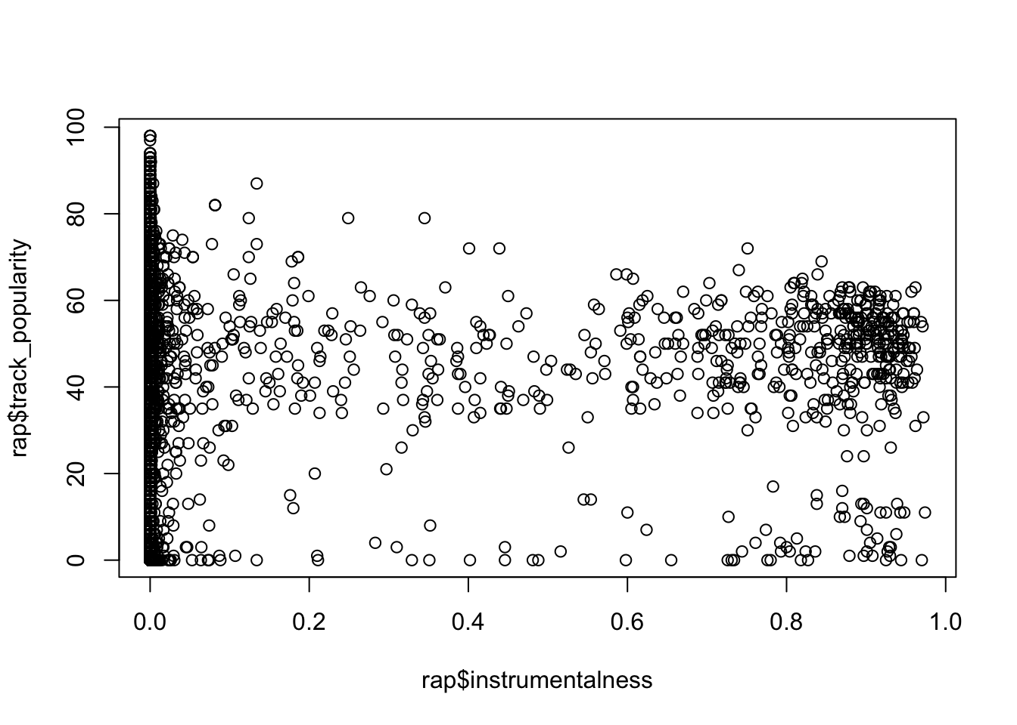

Slide 6
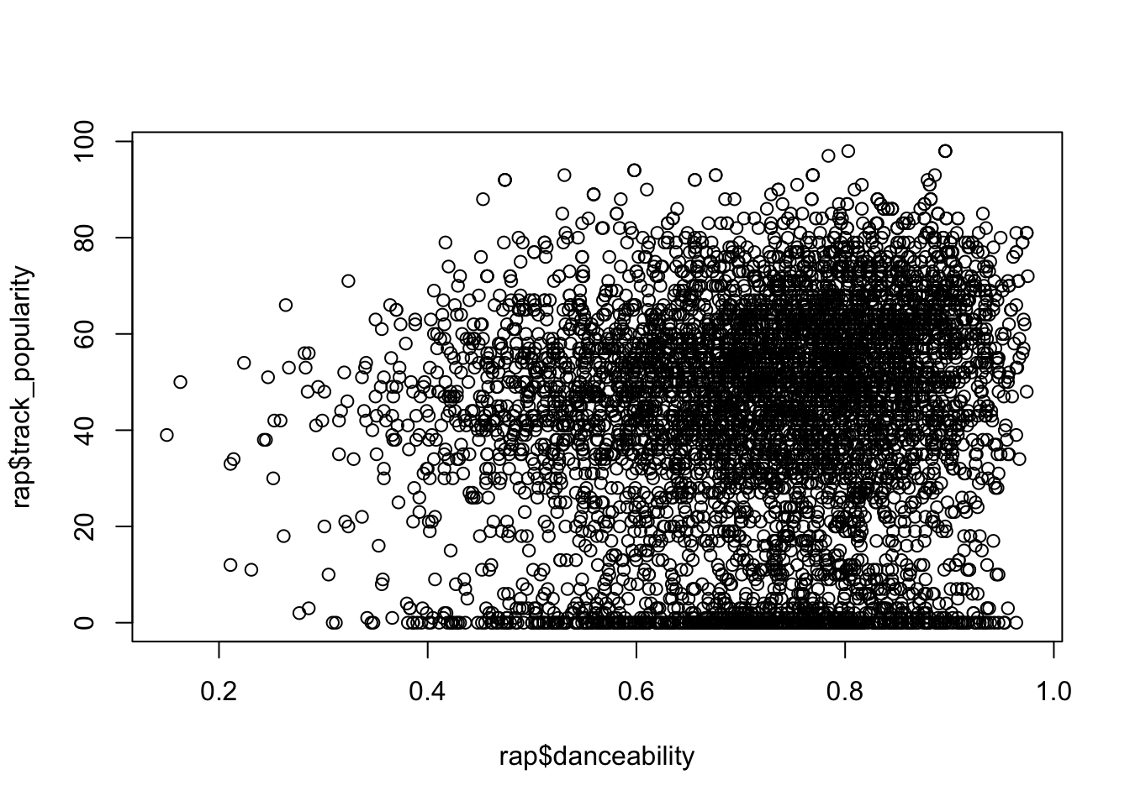

Slide 7
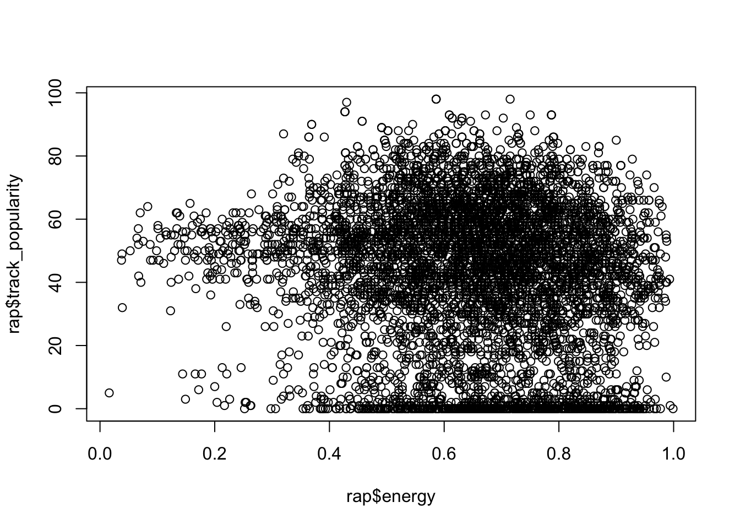

Slide 8
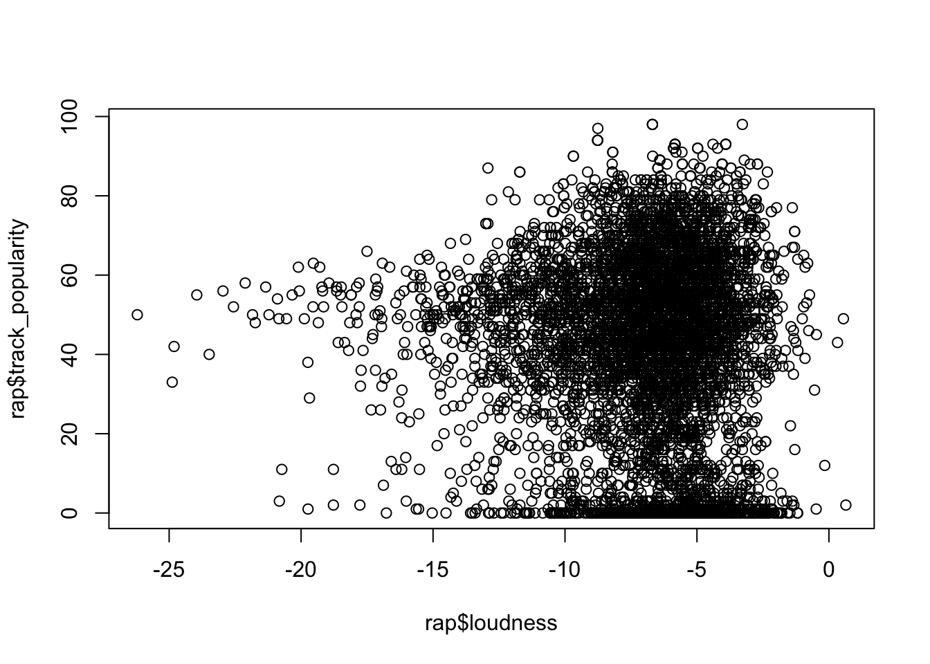

Slide 9
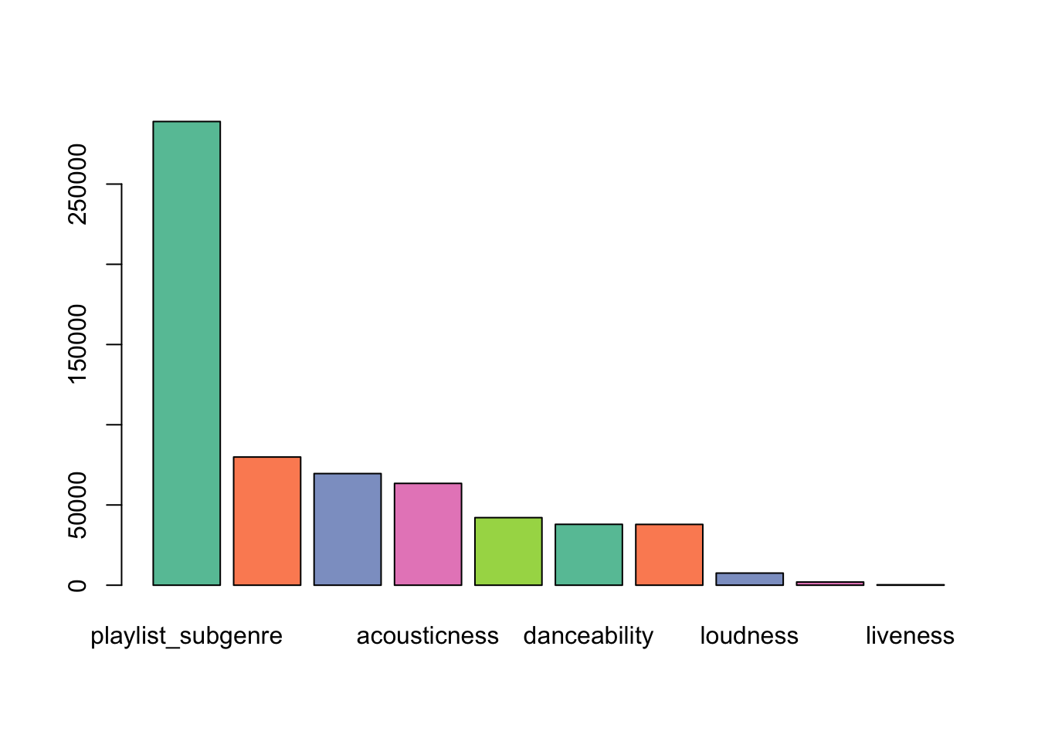
Application of Train, Tune, and Test

Slide 10
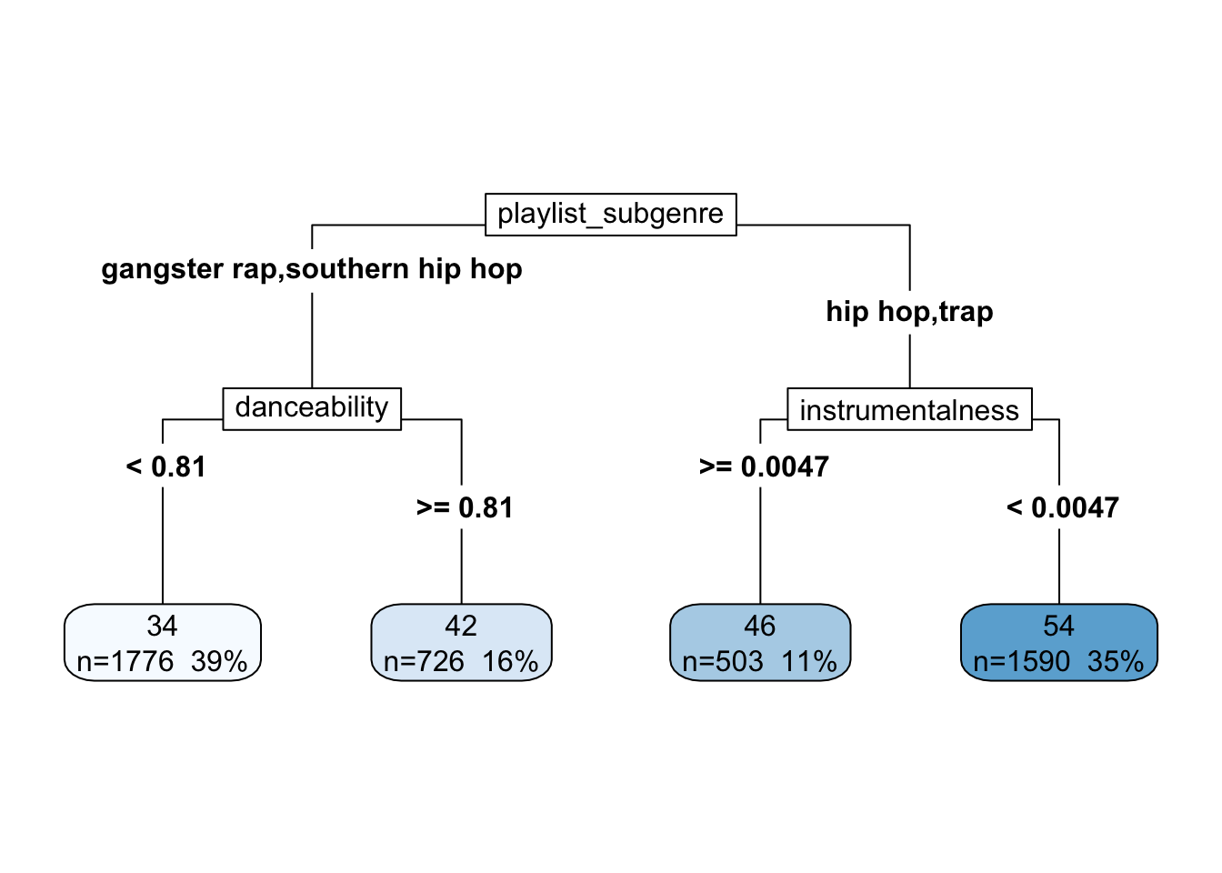
Application of Train, Tune, and Test

Slide 11
Issues with model
For this model, the optimal maxdepth = 3. RMSE = 21.49486, which is a very high error rate since the track_popularity is on a scale from 0-100. Rsquared = 0.1417226, which is also a very poor evaluation since Rsquared is from 0-1 and we want to get closer to 1
These metrics are what led us to switch our approach as descrived above. For a musician, the important outcome may not be a numeric representation of the popularity of a song, but rather it may be whether a song was generally popular. This may also be relative for the genre of music based on the number or types of listeners. Let’s turn the continuous popularity column into a factor with high and low.

Slide 12
Application of Train, Tune, and Test

Slide 13
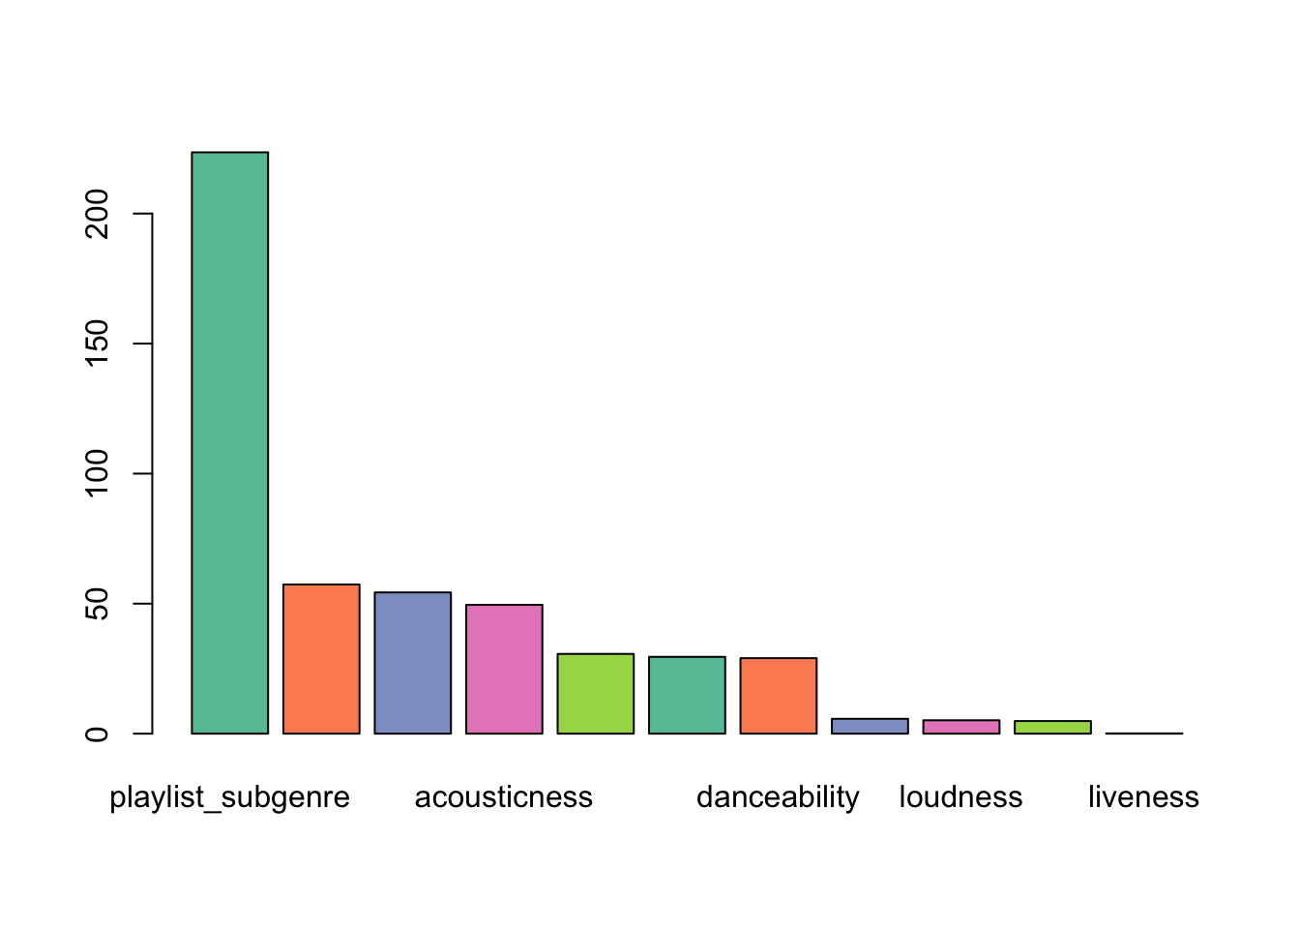
Application of Train, Tune, and Test

Slide 14
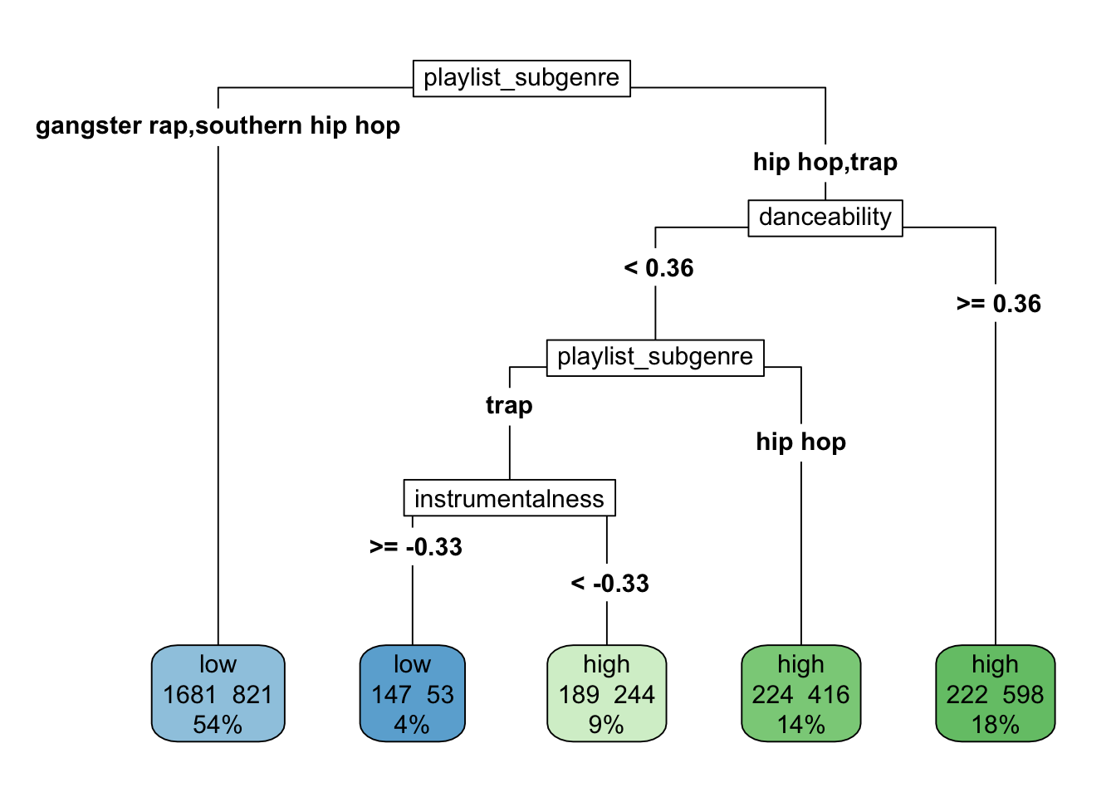
Application of Train, Tune, and Test

Slide 15
Reflection
The final accuracy in the test model for rap using two levels of popularity is 69.3%. The Kappa for this model is 0.373.
Unfortunately, there was an issue dealing with 3 levels due to issues with inter polarity and a ROC method was used instead, so the model used for the other genres seems to be having issues with the rap data set.
On the bright side, I was able to determine the important factors, which were playlist_subgenre, danceability, and instrumentalness.
If I had more time, I would have looked into better ideas for modelling the data and may have been able to successfully get a much more accurate answer.

